Slide 1
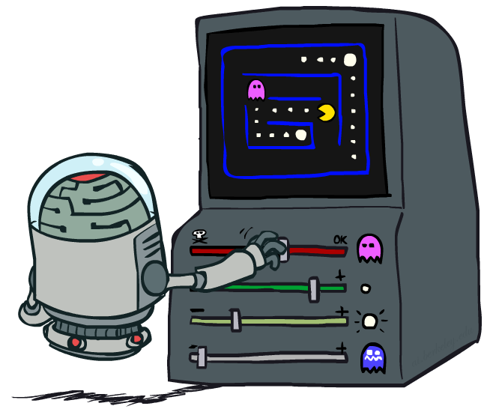
Artificial Intelligence
Reinforcement Learning (Part 2)
CS 444 – Spring 2021
Dr. Kevin Molloy
Department of Computer Science
James Madison University
Much of this lecture is taken from
Dan Klein and Pieter Abbeel AI class at UC Berkeley

Slide 2
Announcements
HW 6 due tonight.
Quiz 3a will be published today after class and due before class next Tuesday.
HW 7 will be release over the weekend and will focus on reinforcement learning.
PA 3 is posted on the class website.

Slide 3

Reinforcement Learning
We still assume an MDP:
A set of states s ∈ S
A set of actions (per state) A
A model T(s,a,s’)
A reward function R(s,a,s’)
Still looking for a policy π(s)
New twist: don’t know T or R, so must try out actions
Big idea: Compute all averages over T using sample outcomes
Figure from Berkley AI

Slide 4
The Story So Far: MDPs and RL
Known MDP: Offline Solution
Goal Technique
Compute V*, Q*, π* Value / policy iteration
Evaluate a fixed policy π Policy evaluation
Unknown MDP: Model-Based
Unknown MDP: Model-Free
Goal Technique
Compute V*, Q*, π* VI/PI on approx. MDP
Evaluate a fixed policy π PE on approx. MDP
Goal Technique
Compute V*, Q*, π* Q-learning
Evaluate a fixed policy π Value Learning
Figure from Berkley AI

Slide 5
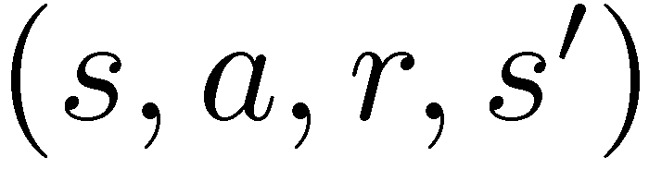
Model-Free Learning
s
Model-free (temporal difference) learning
Experience world through episodes
Update estimates each transition
Over time, updates will mimic Bellman updates
a
s, a
r
s’
a’
s’, a’
s’’
Figure from Berkley AI

Slide 6
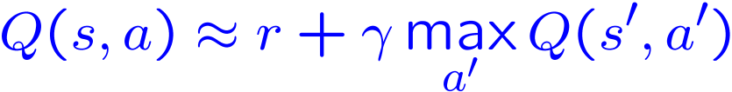
Q-Learning
We’d like to do Q-value updates to each Q-state:
But can’t compute this update without knowing T, R
Instead, compute average as we go
Receive a sample transition (s,a,r,s’)
This sample suggests
But we want to average over results from (s,a) (Why?)
So keep a running average
Figure from Berkley AI

Slide 7

Q-Learning Properties
Amazing result: Q-learning converges to optimal policy -- even if you’re acting suboptimally!
This is called off-policy learning
Caveats:
You have to explore enough
You have to eventually make the learning rate
small enough
… but not decrease it too quickly
Basically, in the limit, it doesn’t matter how you select actions (!)
[Demo: Q-learning – auto – cliff grid (L11D1)]
Figure from Berkley AI

Slide 8
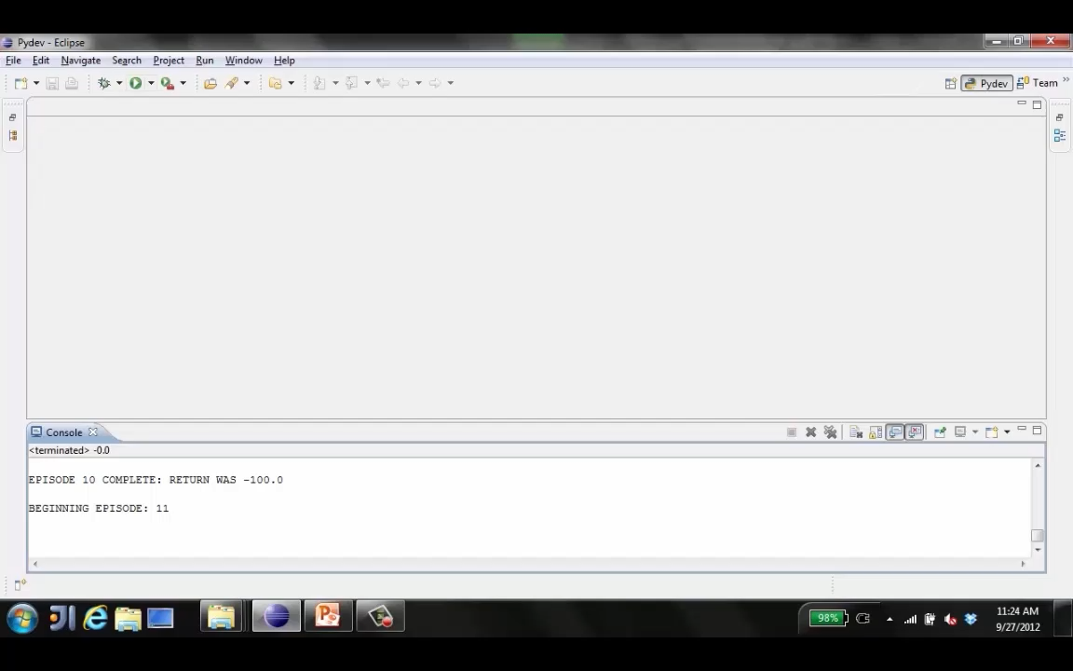
Example: Q-Learning Auto Cliff Grid
Figure from Berkley AI

Slide 9
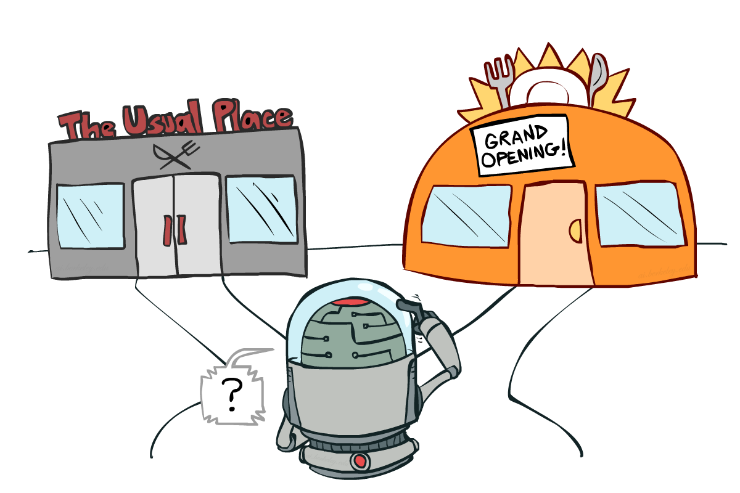
Exploration vs. Exploitation
Figure from Berkley AI

Slide 10

How to Explore?
Several schemes for forcing exploration
Simplest: random actions (ε-greedy)
Every time step, flip a coin
With (small) probability ε, act randomly
With (large) probability 1-ε, act on current policy
Problems with random actions?
You do eventually explore the space, but keep thrashing around once learning is done
One solution: lower ε over time
Another solution: exploration functions
[Demo: Q-learning – manual exploration – bridge grid (L11D2)] [Demo: Q-learning – epsilon-greedy -- crawler (L11D3)]
Figure from Berkley AI

Slide 11
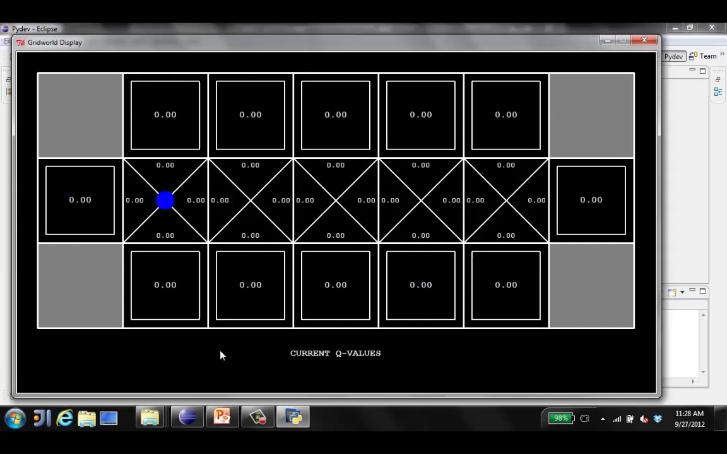
Demo Q-Learning – Manual Exploration – Bridge Grid
Figure from Berkley AI

Slide 12
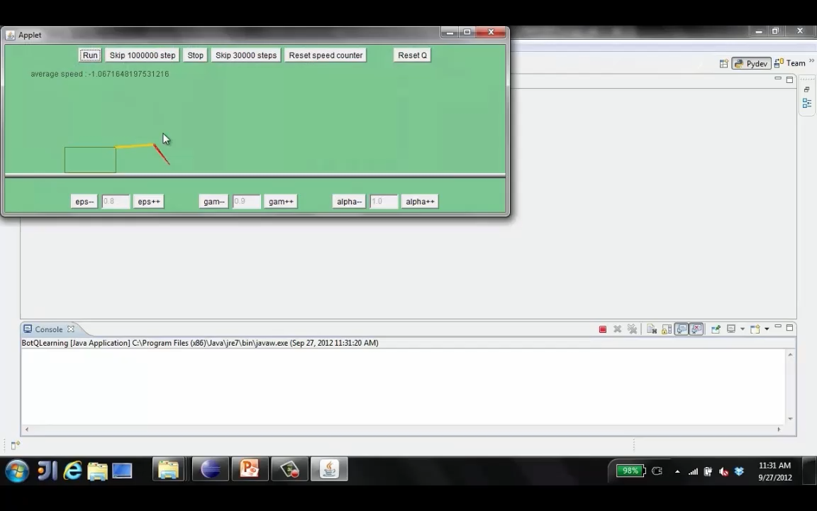
Q-Learning – Epsilon Greedy - Crawler
Figure from Berkley AI

Slide 13
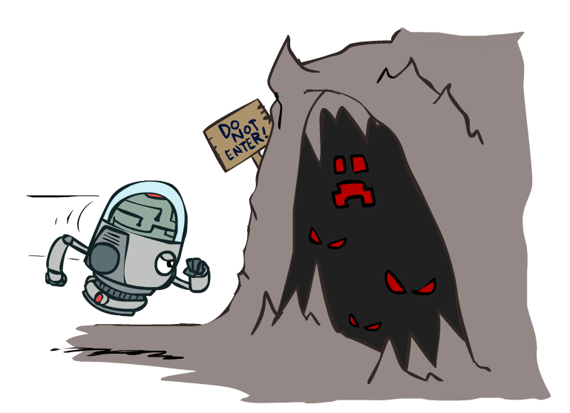
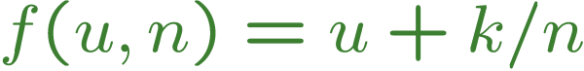
Exploration Functions
When to explore?
Random actions: explore a fixed amount
Better idea: explore areas whose badness is not
(yet) established, eventually stop exploring
Exploration function
Takes a value estimate u and a visit count n, and
returns an optimistic utility, e.g.
Note: this propagates the “bonus” back to states that lead to unknown states as well!
Regular Q-Update:
Modified Q-Update:
[Demo: exploration – Q-learning – crawler – exploration function (L11D4)]
Figure from Berkley AI

Slide 14
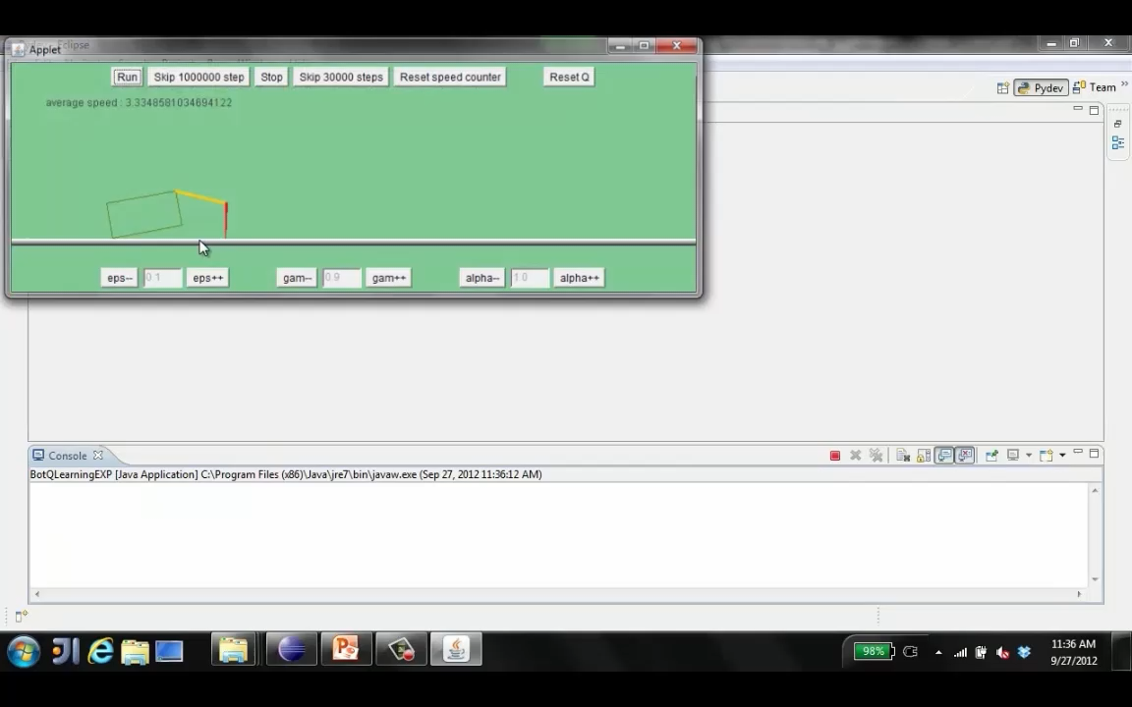
Example: Learning to Walk
Figure from Berkley AI

Slide 15
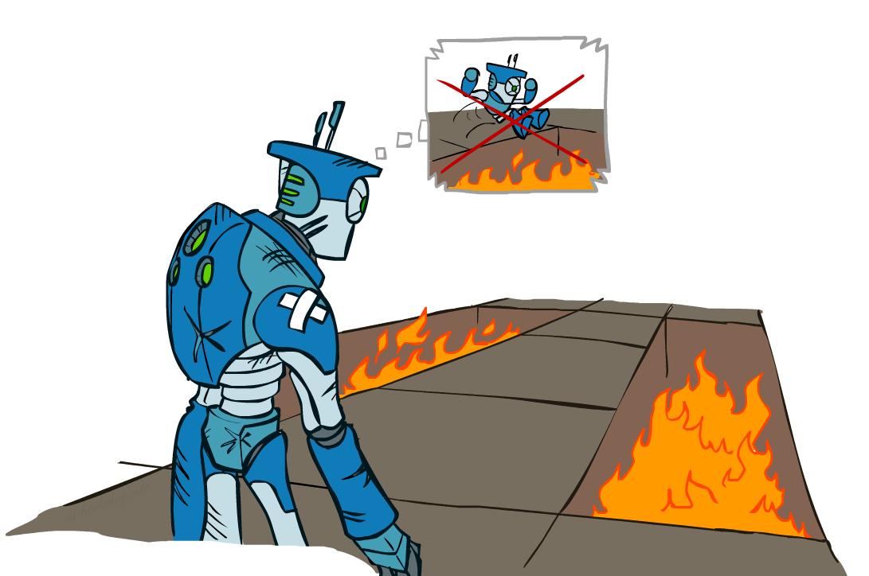
Regrets
Even if you learn the optimal policy, you still make mistakes along the way!
Regret is a measure of your total mistake cost: the difference between your (expected) rewards, including youthful suboptimality, and optimal (expected) rewards
Minimizing regret goes beyond learning to be optimal – it requires optimally learning to be optimal
Example: random exploration and exploration functions both end up optimal, but random exploration has higher regret
Figure from Berkley AI

Slide 16
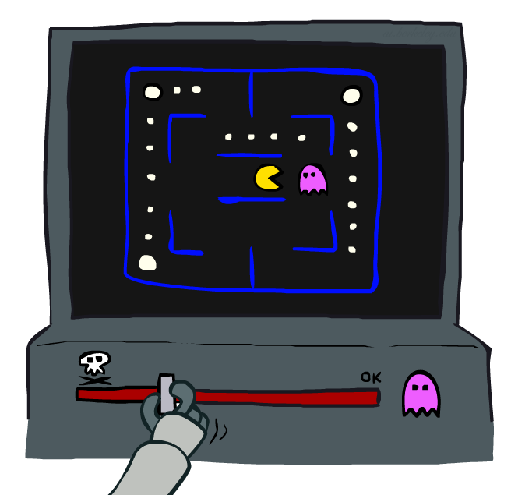
Approximate Q-Learning
Figure from Berkley AI

Slide 17
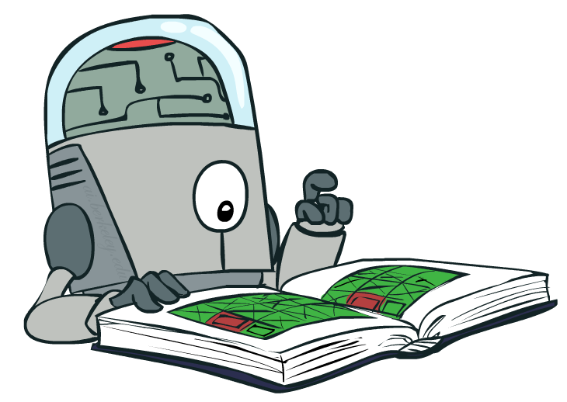
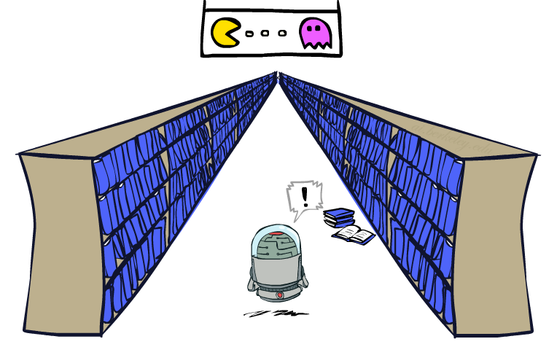
Generalizing Across States
Basic Q-Learning keeps a table of all q-values
In realistic situations, we cannot possibly learn about every single state!
Too many states to visit them all in training
Too many states to hold the q-tables in memory
Instead, we want to generalize:
Learn about some small number of training states from experience
Generalize that experience to new, similar situations
This is a fundamental idea in machine learning, and we’ll see it over and over again
Figure from Berkley AI
[demo – RL pacman]

Slide 18
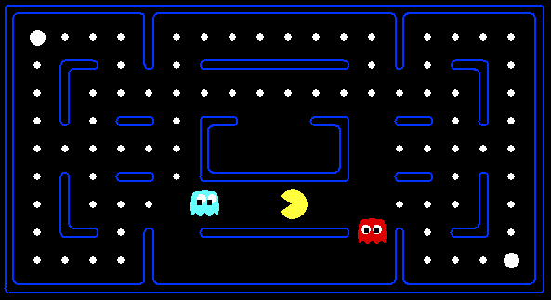



Example: Pacman
Let’s say we discover through experience that this state is bad:
In naïve q-learning, we know nothing about this state:
Or even this one!
[Demo: Q-learning – pacman – tiny – watch all (L11D5)]
[Demo: Q-learning – pacman – tiny – silent train (L11D6)]
[Demo: Q-learning – pacman – tricky – watch all (L11D7)]
Figure from Berkley AI

Slide 19
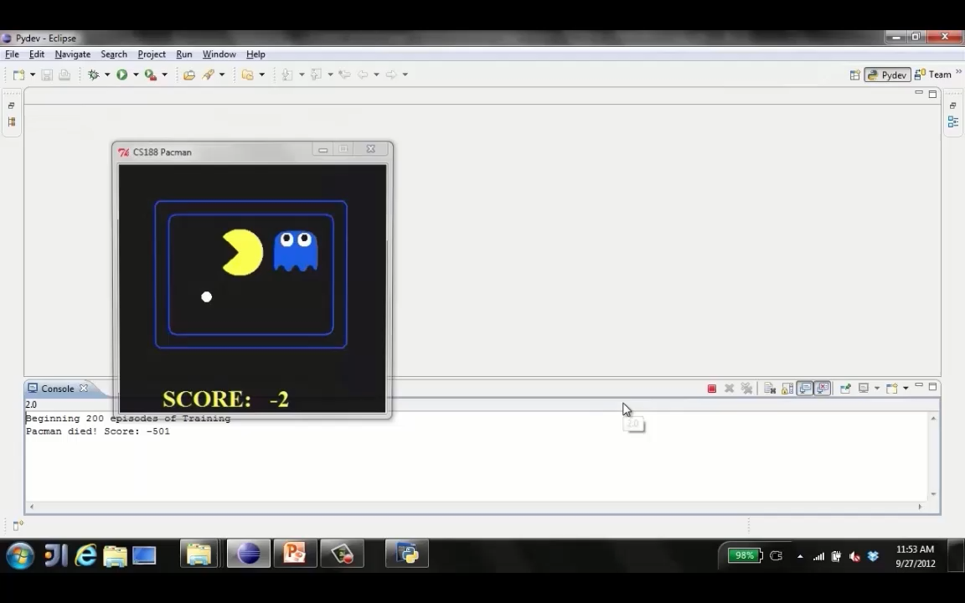
Q-Learning Pacman – Tiny – Watch All
Figure from Berkley AI

Slide 20
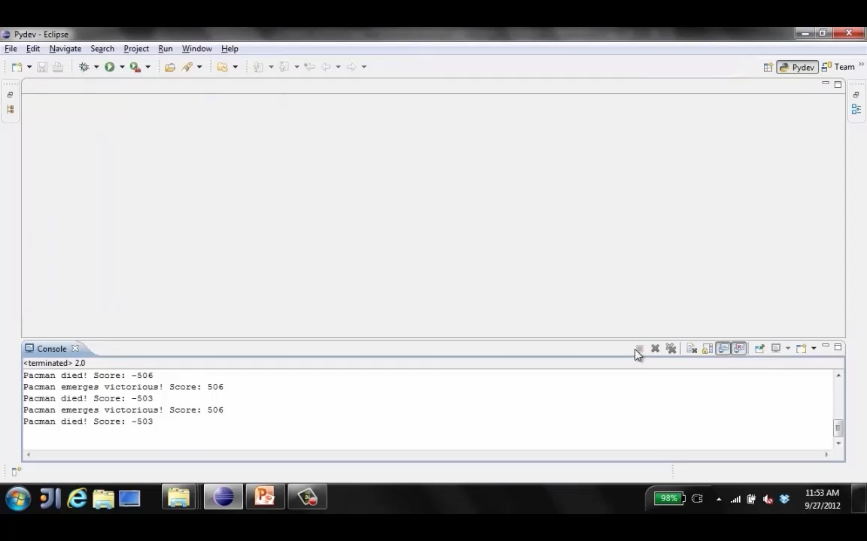
Q-Learning Pacman – Tiny – Silent Train
Figure from Berkley AI

Slide 21
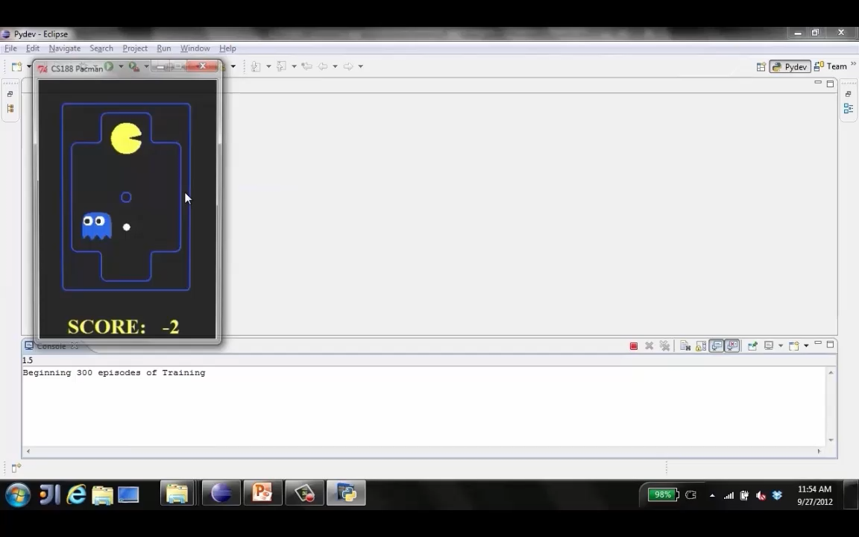
Q-Learning Pacman – Tricky – Watch All
Figure from Berkley AI

Slide 22
Feature-Based Representations
Solution: describe a state using a vector of features (properties)
Features are functions from states to real numbers (often 0/1) that capture important properties of the state
Example features:
Distance to closest ghost
Distance to closest dot
Number of ghosts
1 / (dist to dot)²
Is Pacman in a tunnel? (0/1)
…… etc.
Is it the exact state on this slide?
Can also describe a q-state (s, a) with features (e.g. action moves closer to food)
Figure from Berkley AI

Slide 23
Linear Value Functions
Using a feature representation, we can write a q function (or value function) for any state using a few weights:
Advantage: our experience is summed up in a few powerful numbers
Disadvantage: states may share features but actually be very different in value!
Figure from Berkley AI

Slide 24

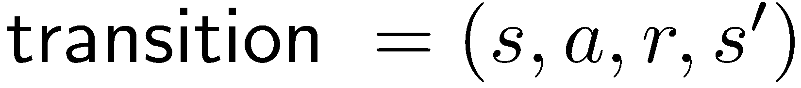
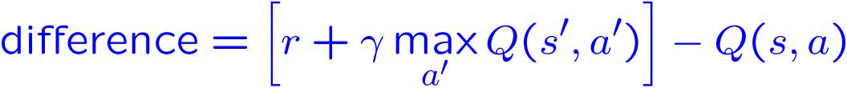
Approximate Q-Learning
Q-learning with linear Q-functions:
Intuitive interpretation:
Adjust weights of active features
E.g., if something unexpectedly bad happens, blame the features that were on: disprefer all states with that state’s features
Formal justification: online least squares
Exact Q’s
Approximate Q’s
Figure from Berkley AI

Slide 25
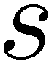
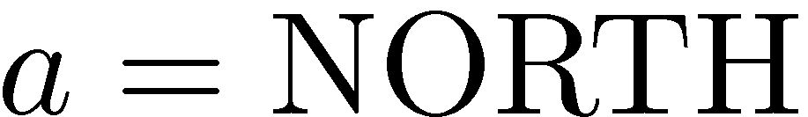
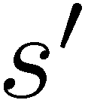
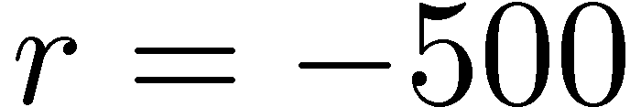
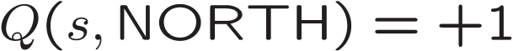
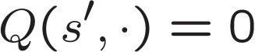
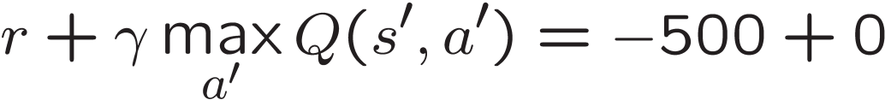
Example: Q-Pacman
[Demo: approximate Q-learning pacman (L11D10)]
Figure from Berkley AI

Slide 26
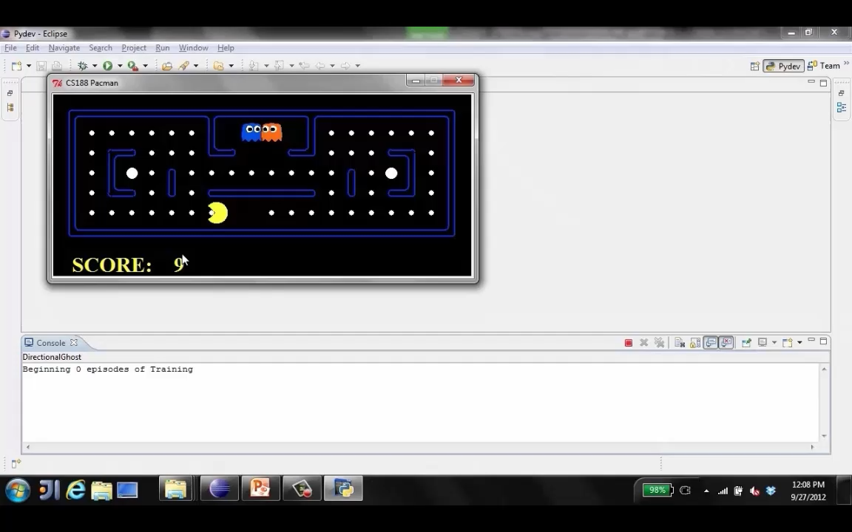
Video: Approximate Q-Learning Pacman
Figure from Berkley AI

Slide 27
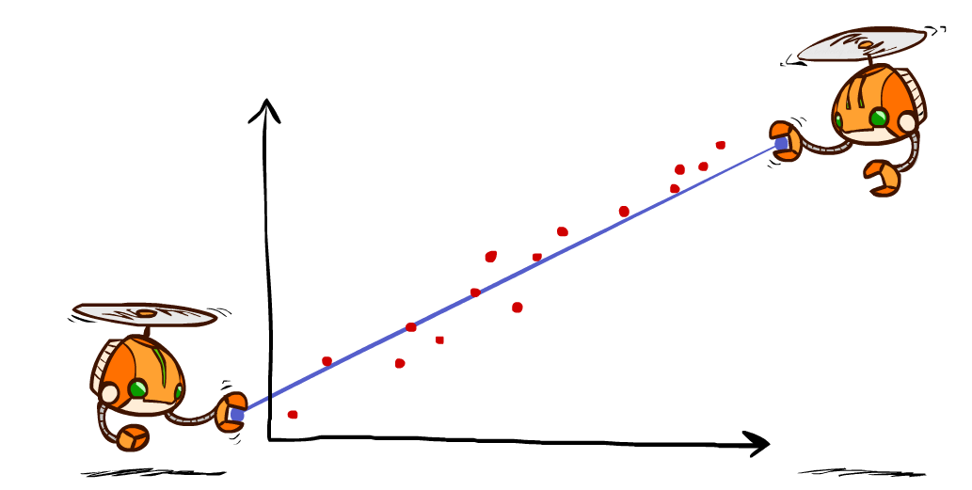
Q-Learning and Least Squares
Figure from Berkley AI

Slide 28
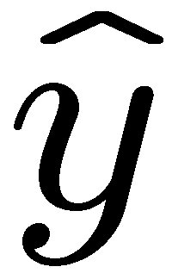
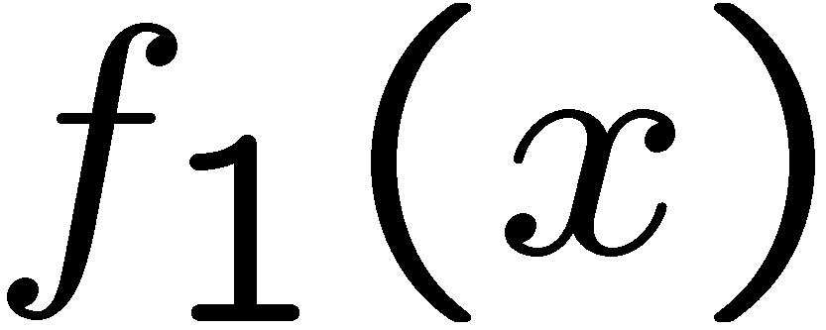
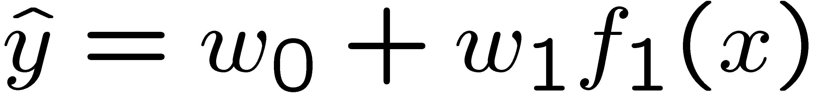
Linear Approximation: Regression*
40
26
24
20
22
20
30
20
40
0
0
20
30
10
20
0
10
0
Prediction:
Prediction:
Figure from Berkley AI

Slide 29
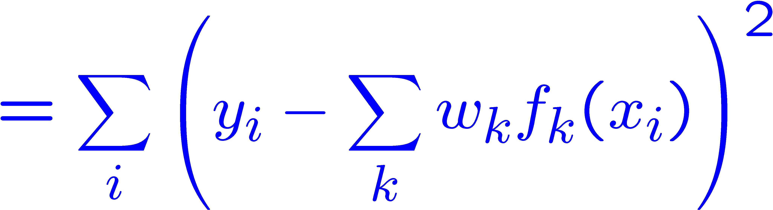
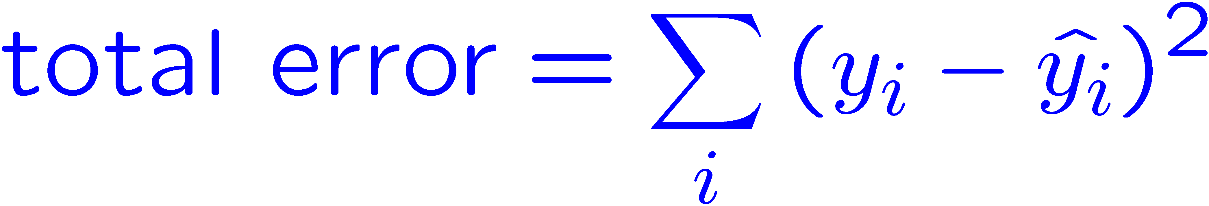
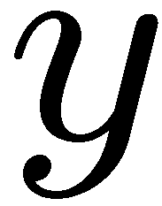
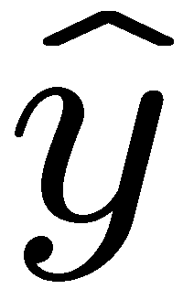

Optimization: Least Squares *
Error or “residual”
Observation
Prediction
0
0
20
Figure from Berkley AI

Slide 30
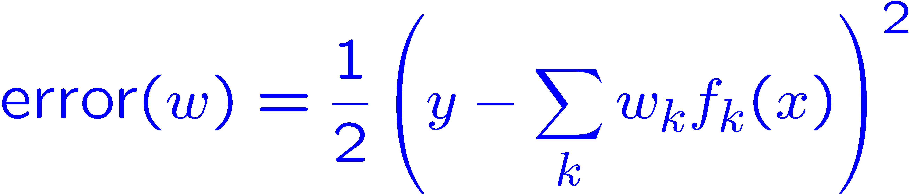
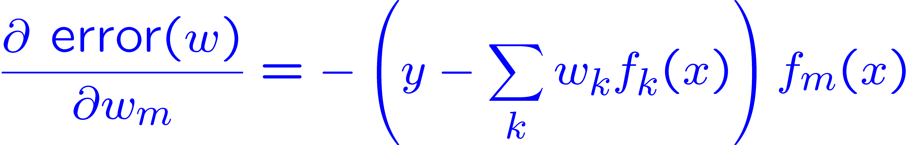
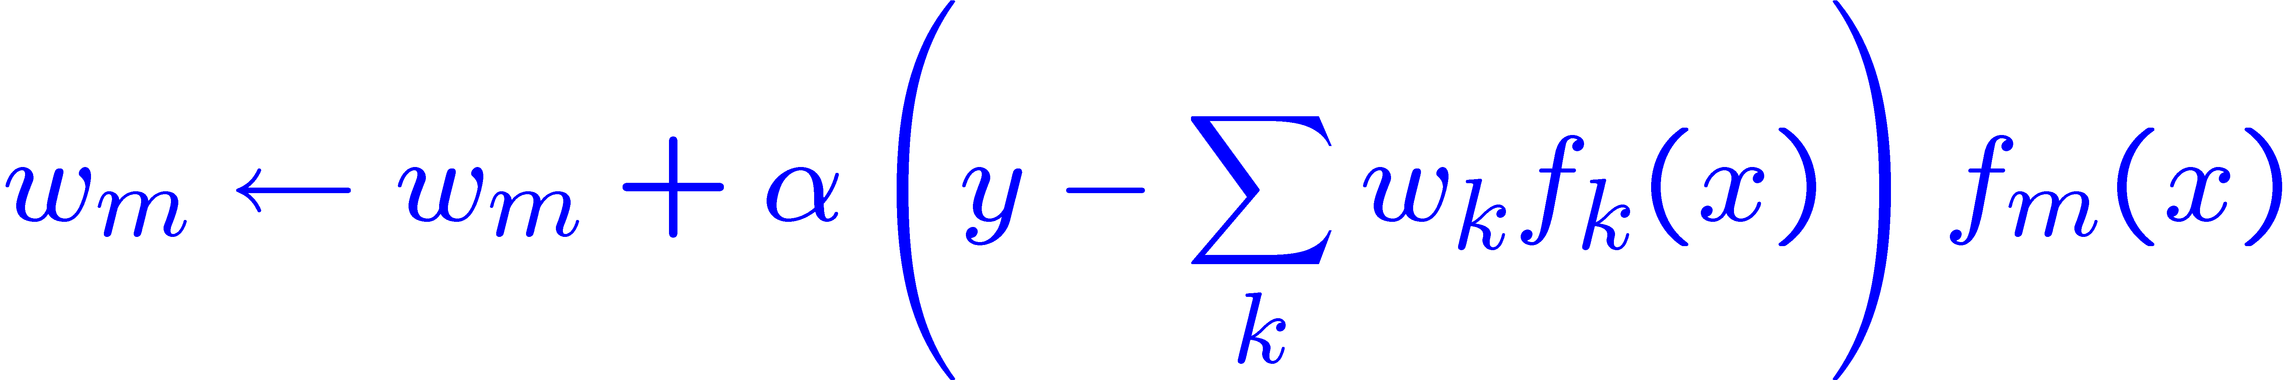
Minimizing Error*
Imagine we had only one point x, with features f(x), target value y, and weights w:
Approximate q update explained:
“target”
“prediction”
Figure from Berkley AI

Slide 31
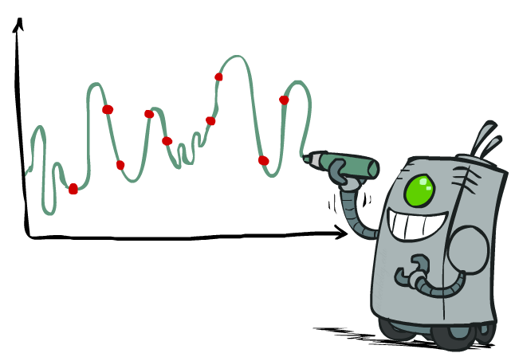
Overfitting: Why Limiting Capacity Can Help*
Figure from Berkley AI

Slide 32
Policy Search
Problem: often the feature-based policies that work well (win games, maximize utilities) aren’t the ones that approximate V / Q best
Q-learning’s priority: get Q-values close (modeling)
Action selection priority: get ordering of Q-values right (prediction)
We’ll see this distinction between modeling and prediction again later in the course
Solution: learn policies that maximize rewards, not the values that predict them
Policy search: start with an ok solution (e.g. Q-learning) then fine-tune by hill climbing on feature weights
Figure from Berkley AI

Slide 33
Policy Search
Simplest policy search:
Start with an initial linear value function or Q-function
Nudge each feature weight up and down and see if your policy is better than before
Problems:
How do we tell the policy got better?
Need to run many sample episodes!
If there are a lot of features, this can be impractical
Better methods exploit lookahead structure, sample wisely, change multiple parameters…
Figure from Berkley AI

Slide 34

Helicopter Flying
Video from Andrew Ng

Slide 35
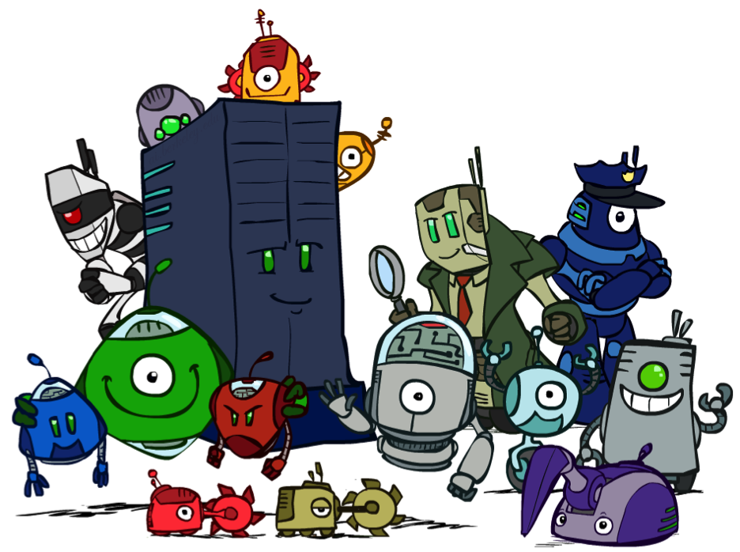
Conclusion
We’re done with Part I: Search and Planning!
We’ve seen how AI methods can solve problems in:
Search
Constraint Satisfaction Problems
Games
Markov Decision Problems
Reinforcement Learning
Next up: Part II: Reasoning with Logic!
Figure from Berkley AI

